Slide 1
Machine Rename and OU Movement Solution

Slide 2
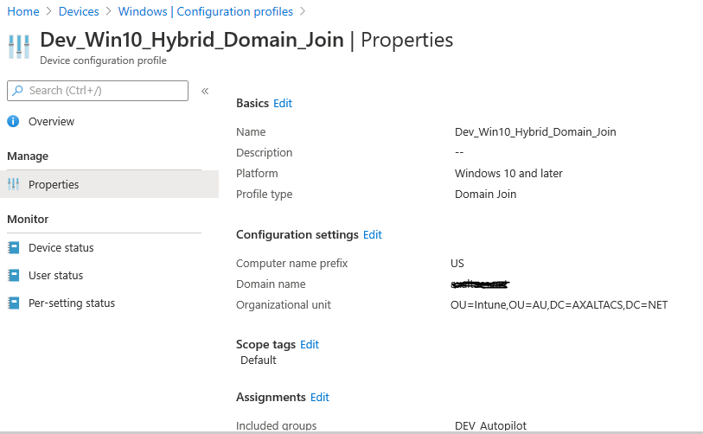
Intune Limitations - Problem Area
Microsoft Intune Hybrid Join Autopilot comes with few limitations:
Computer name prefix: Enter a prefix for the device name. Computer names are 15 characters long. After the prefix, the remaining 15 characters are randomly generated.
Organizational unit (optional): Enter the full path (distinguished name) to the organizational unit (OU) the computer accounts are to be created. For example, enter "CN=Users,DC=Contoso,DC=com". If you don't enter a value, a well-known computer object container is used. Also even if we supply OU then then also there is limitation of one OU where as Organization has multiple OU it will move object later on manually via Admin.
Ref Link : https://docs.microsoft.com/en-us/mem/intune/configuration/domain-join-configure

Slide 3
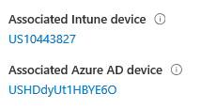
Solution
Computer name : Prefix plus Serial Number of machine.
Power Shell Script designed to automate this will be wrapped up as Intune app and deployed to target machines.
Script queries serial number of machine and stores in variable and then concatenates Prefix and variable and Rename with this Value.
Code Snippet : $Serial = Get-WmiObject Win32_bios | Select-Object -ExpandProperty SerialNumber
$NewName = "US$Serial"
Also added a check to see it has connectivity to domain before running, So if its unable to reach domain, It be stored as schedule task and try to run next time when user logout and user login.

Slide 4
Solution…Continuation
Power Shell Script Automation Continuation:
Organizational unit (optional): Initially with Intune it will dump to single OU as per design limitation.
Next, our script targeted as Intune Win32 App to newly build machines, will dump machine to Specific OU defined in logic.
Its Queries current logged in user’s, AD User attributes, queries Machine Attributes and then move the Object on conditions when met.
Example : If I get a user who is part of Gurugram Office, so I get that from this AD attributes and then Move User to Gurugram Office OU.
In this way we are saved from creating multiple domain join profile or manual work by Admin to move object after creation via Intune to specific regions according to OU diversification

Slide 5
Features
Checks Connectivity to Domain before rename and OU movement.
If no connectivity to Domain discontinues and run next time as Schedule Task
Rename machine according to Organization Standard (Serial Number and Country)
If serial Number of machine is higher than 15 digit which is limit for windows it truncates to first 15 digit
OU Movement without multiple domain join profile or manual overhead or moving object by admin

Slide 6
Costing Projection
Implementation : Two resources Involved projected around USD 5000
Actual Value Delivered : USD 80000 yearly. Saved cost from DSS Engineer and Administrator work for rename as well OU movement

